Slide 1



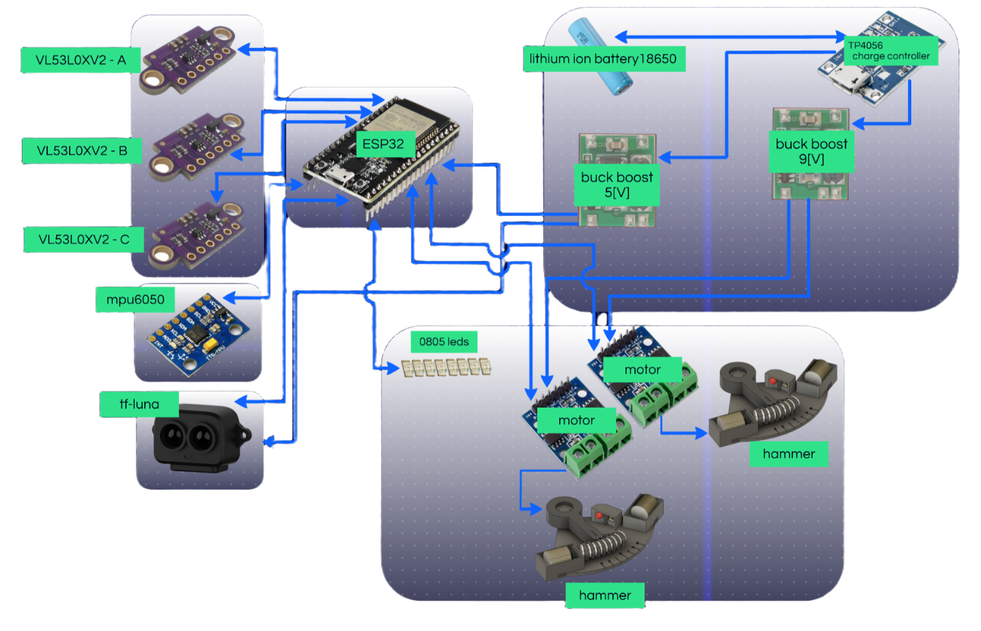
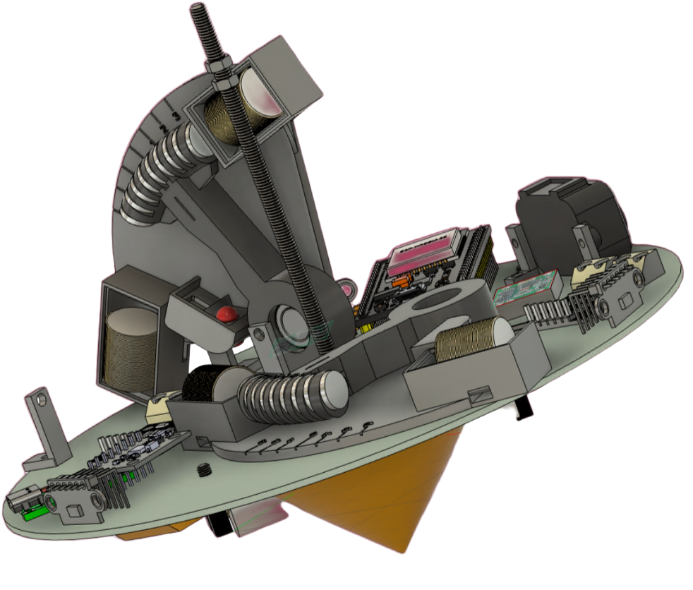
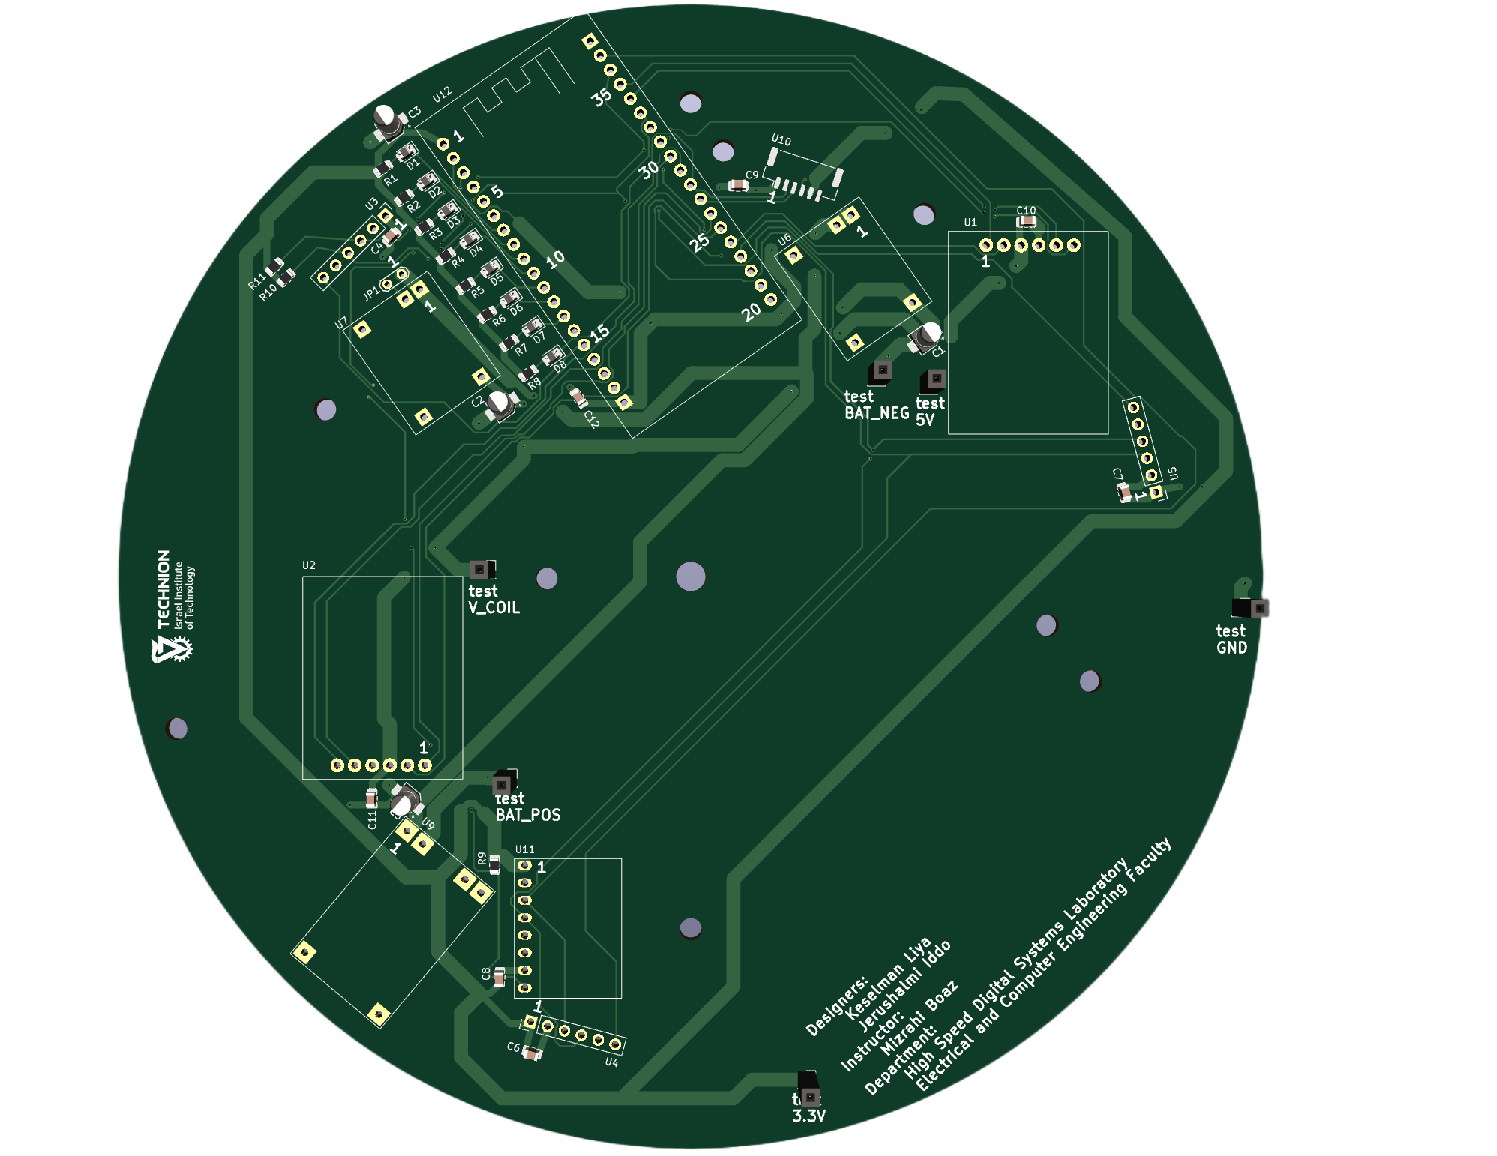
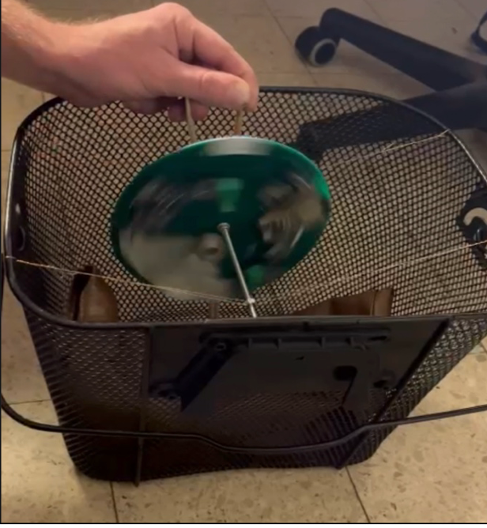
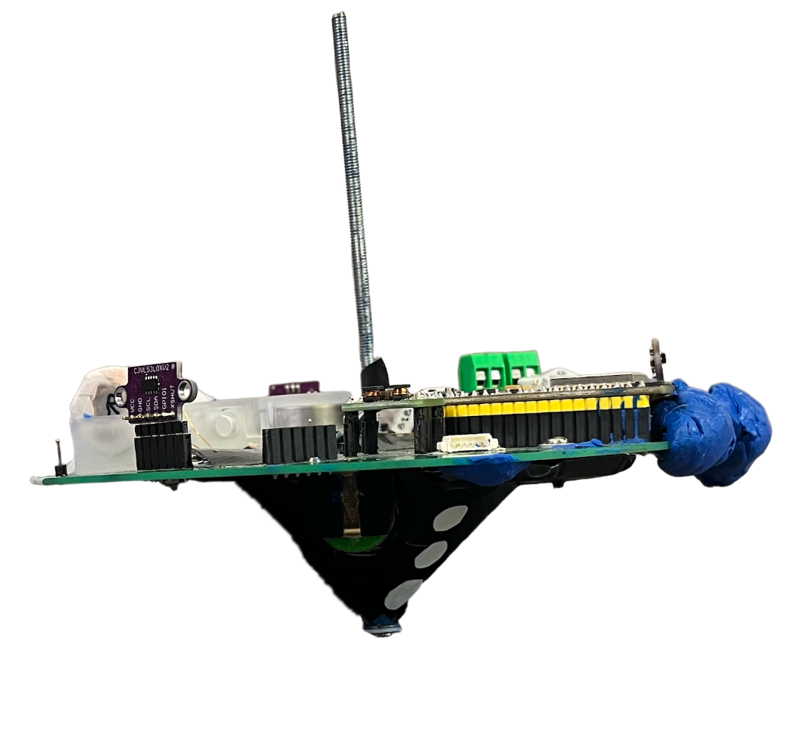
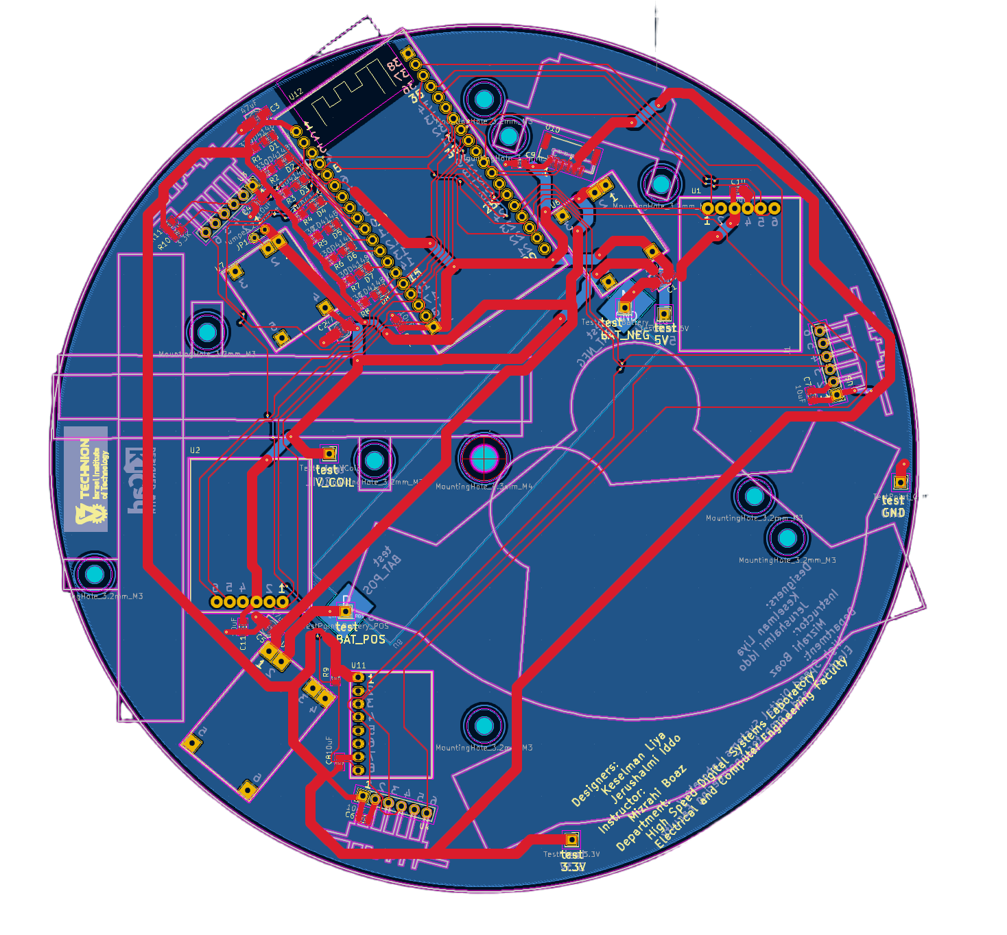
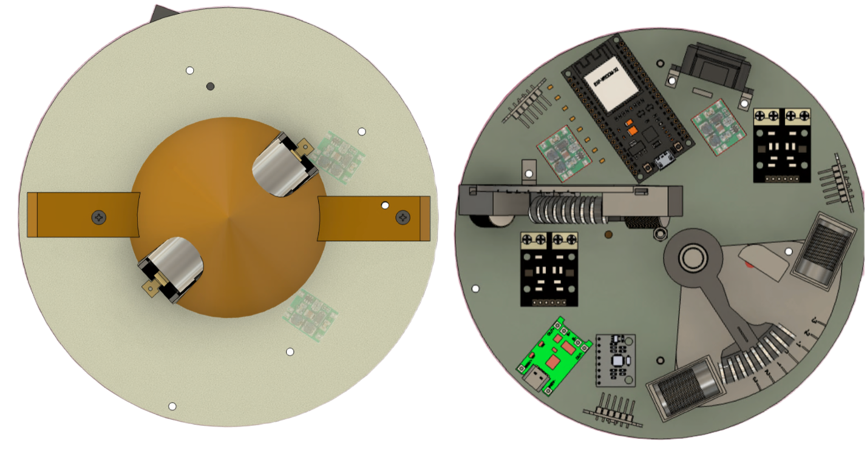
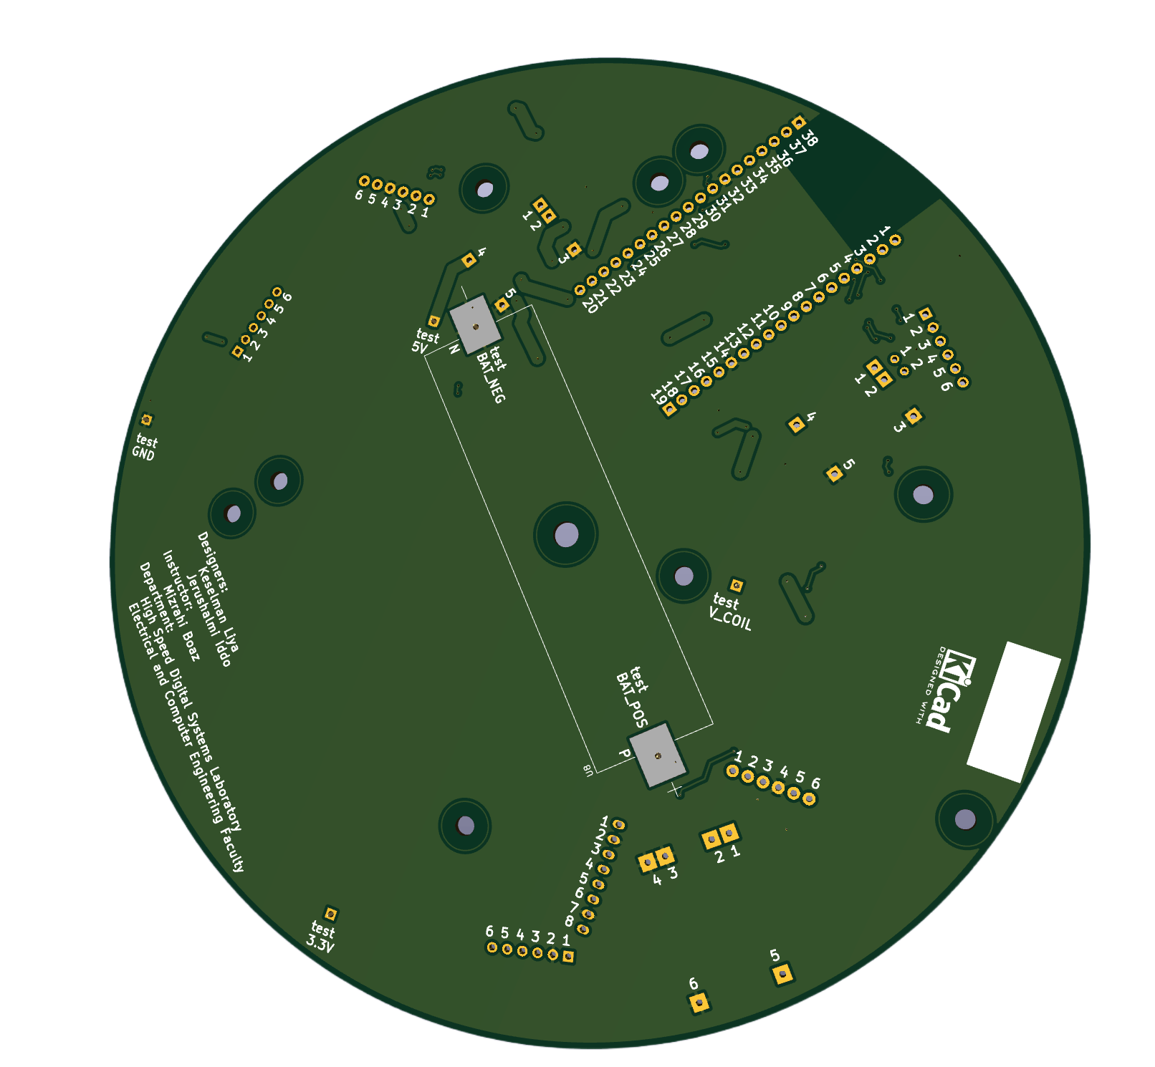
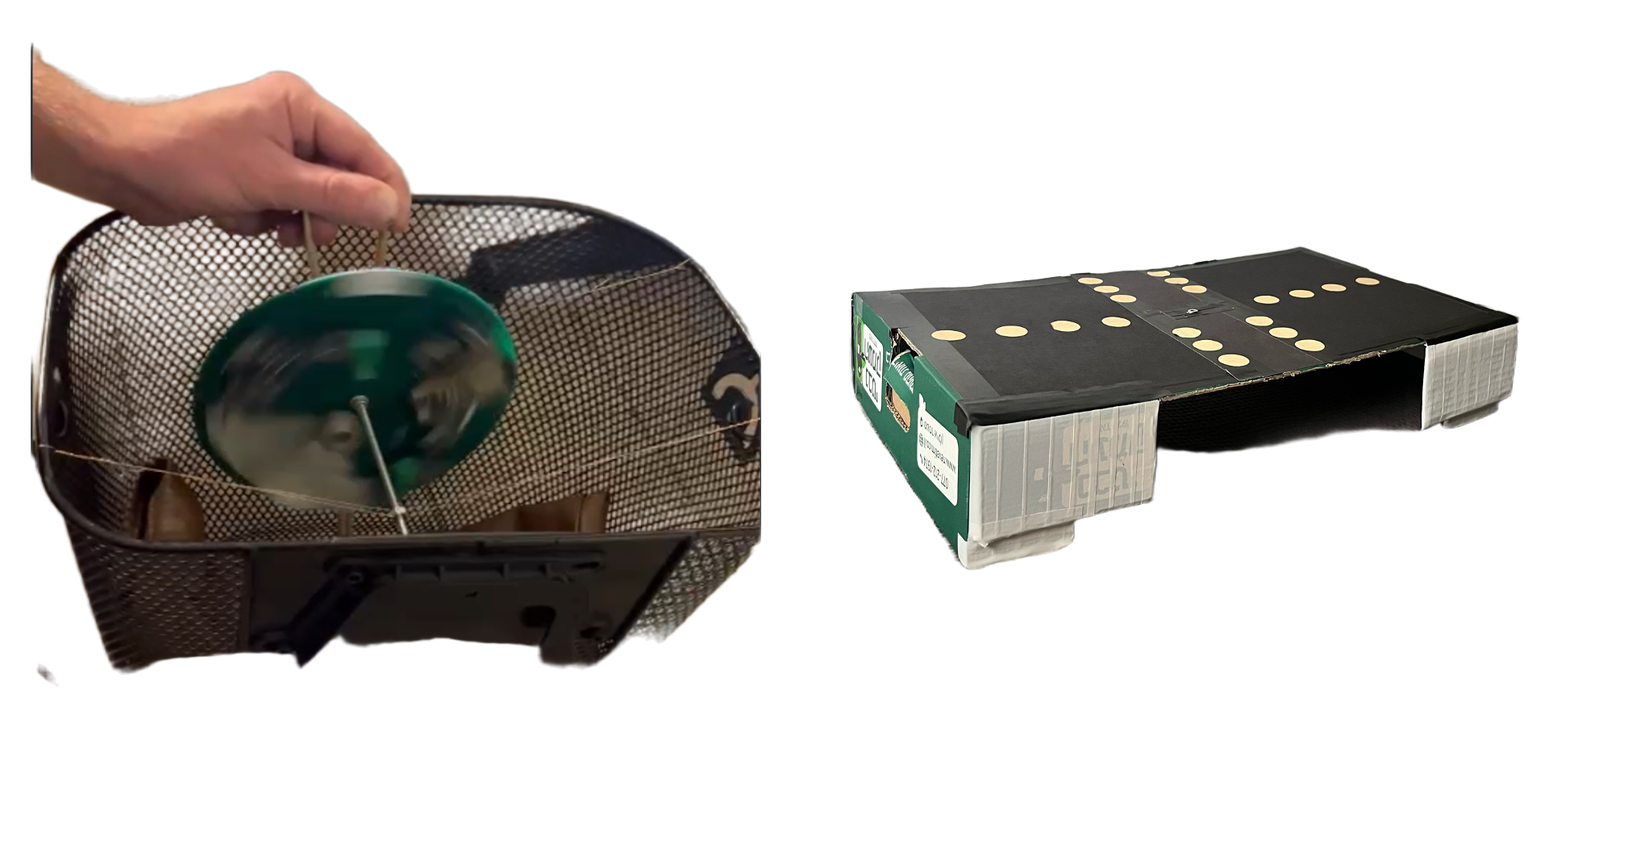
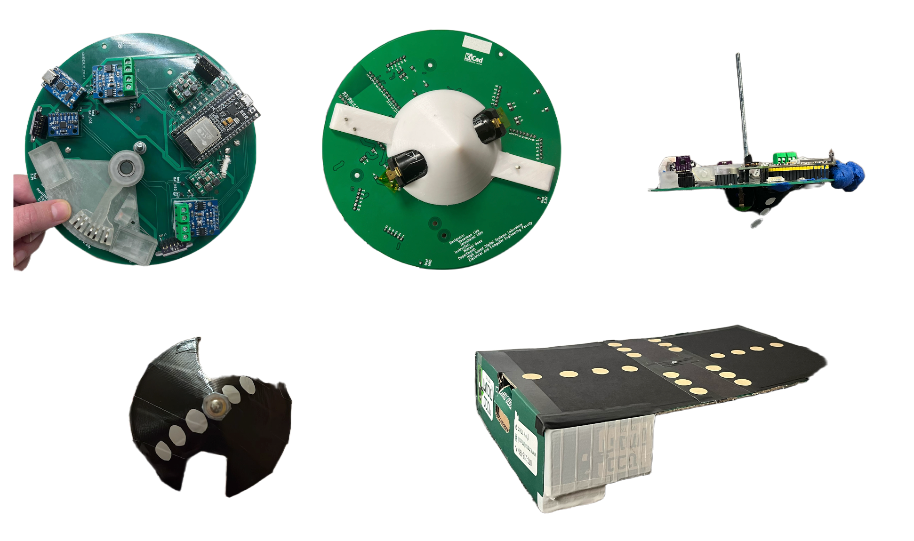
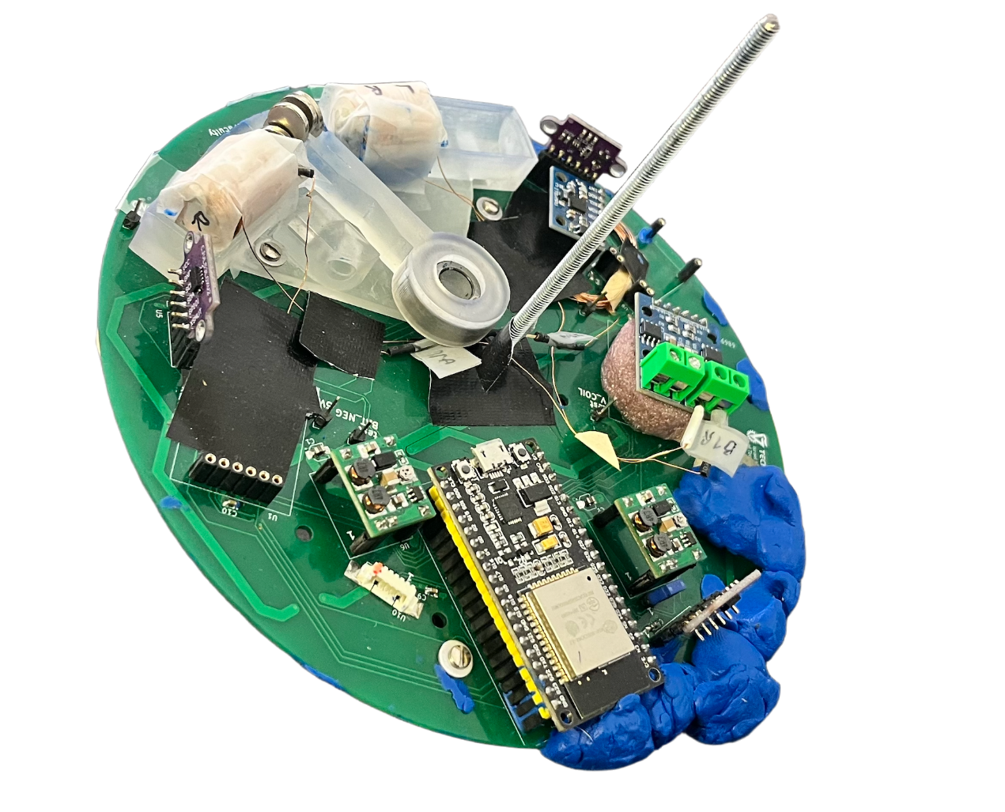
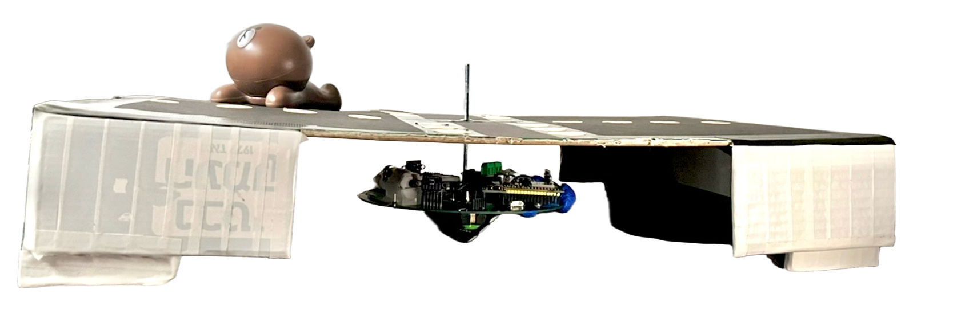

RETHINKING MOTION- A New Era of Compact Tactile Robotics
Keselman Liya & Jerushalmi Iddo , Supervised by: Mizrachi Boaz
Small Body. Massive Potential.
What if a dreidel could spin with purpose—powered by WiFi, sensors, and mission control?
Spin. Think. Act. The new language of motion starts here.
VISION
TECHNOLOGY
PERFORMANCE
Not a toy. A platform.
• A robotic system born from a traditional symbol
• Modular, programmable, and scalable
• A stepping stone toward swarm robotics and autonomous mobility
• Bridges educational exploration with real-world application
Engineered into 162mm of brilliance.
• Palm-sized custom PCB with ESP32
• 3x VL53L0X Time-of-Flight sensors + MPU6050 gyro/accelerometer
• TF-Luna LiDAR for accurate distance mapping
• Dual L9110 motor drivers controlling magnetic hammer coils
• Real-time Wi-Fi communication + onboard web server
• Smart pinout mapping, noise filtering, and power regulation
Built. Tested. Spinning.
• 30+ seconds of stable spin with full hardware engagement
• Full Built-In Self-Test (BIST) mode per module
• Partial synchronization achieved across sensors, logic, and motors
• Precision physical balancing with custom jig + plasticine
• System robustness demonstrated in repeatable testing
HARDWARE OVERVIEW
SOFTWARE OVERVIEW
Brains behind the spin – Embedded C++ on ESP32
• Modular Arduino code structure with sensor, motor, and
communication layers
• Hammer activation driven by internal timing cycles and motor phase logic
• Sensor fusion: ToF + LiDAR + MPU6050 for environment &
motion awareness
• Live Wi-Fi data logging via ESP32 web server
• UART debug interface & I2C diagnostic routines
• BIST system runs at startup before spin sequence begins
3D MODEL
PCB LAYOUT
STABILIZATION SYSTEM
internal component layout
routing
jig
plasticine
FULLY ASSEMBLED SPINNING-TOP
Full project & source code available at:
https://github.com/liyakeselman/Spinning_Top_Hardware_Part_1

